Slide 1

Digital Challenge
Ankur Chaudhary

Slide 2

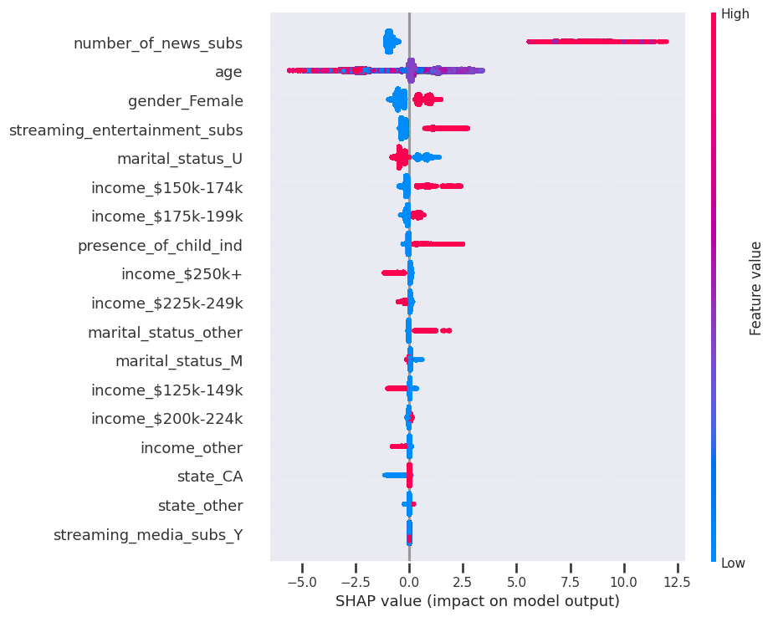
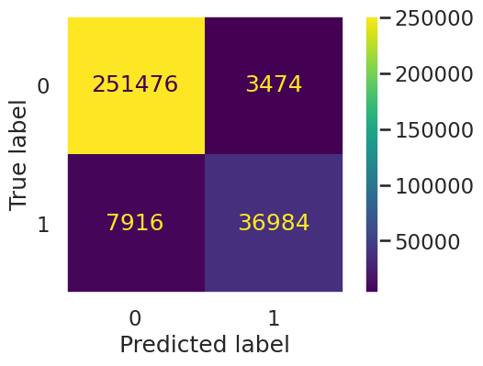

Feature impact and confusion matrix

Slide 3
Scores/insights usage and next steps
Use the scores in scores.csv to target individuals who are prospects, mid level prospects or even at the borderline of not being prospects
Alternate to the scores-based approach, feature values can also be leveraged to create a group-based targeting approach
Next Steps:
Evaluate model for bias
Include more data points if available as well as features
Perform more experiments with data
Monitor model for drift
PKL files can be used to automate the model via solutions like cron , airflow, flask etc.

